Slide 1


Department of Computer Science and Engineering
COOKED FOOD SUPPLY CHAIN ERP MODEL
PRIEE GE19612
MADHUMITHA S (210701142)
LATHIKA P (210701131)
LAKSHMIKANTH M(210701130)

Slide 2
PROBLEM STATEMENT
The cooked food supply chain faces significant challenges spanning procurement inefficiencies, inventory management issues, production bottlenecks, transportation logistics, food safety concerns, inaccurate demand forecasting, traceability issues, and sustainability shortcomings.
These challenges lead to delays, increased costs, wastage, compromised quality, and environmental impact. Addressing these issues is imperative to enhance efficiency, ensure food safety, meet consumer demand, and promote sustainability. By implementing streamlined processes, leveraging technology, enhancing collaboration among stakeholders, and prioritizing food safety and sustainability, the cooked food supply chain can achieve optimization and deliver value to all involved parties, from suppliers to consumers.

Slide 3
ABSTRACT
The basic concept of this project Food Waste Management is to collect the excess/leftover food from donors such as hotels, restaurants, marriage halls, etc and distribute to the needy people .The cooked food supply chain refers to the interconnected network of processes and activities involved in the sourcing, production, distribution, and consumption of cooked or prepared food products.Unlike raw food supply chains, which deal with unprocessed ingredients, the cooked food supply chain manages food items that have undergone cooking, baking, frying, or other forms of preparation before reaching consumers.To maximize the impact of surplus food redistribution, proper storage and preservation techniques are employed to prolong the shelf life of food items. This may involve refrigeration, freezing, vacuum sealing, or other preservation methods tailored to the specific characteristics of each food item. Continuous monitoring and evaluation mechanisms are integrated into SFMS to track the flow of surplus food, assess its impact on alleviating food insecurity, and identify areas for improvement. Data-driven insights gleaned from monitoring efforts enable stakeholders to refine and optimize surplus food management strategies over time.

Slide 4
EXISTING SYSTEM
Surplus food management systems effectively reduce food waste by redistributing excess food to those in need through a combination of technology, partnerships, and policy initiatives. Food rescue organizations like food banks and non-profits collect and distribute surplus food from retailers, restaurants, and farmers. Technology platforms such as OLIO and Too Good To Go facilitate the donation and pickup of surplus food, while blockchain and IoT enhance transparency and safety. Government policies, including laws like the U.S. Good Samaritan Food Donation Act and tax incentives, encourage businesses to donate excess food. Retailers, restaurants, and producers collaborate with these organizations, while public education campaigns and training programs raise awareness and promote best practices. Data analytics and reporting tools further optimize the management of surplus food, ensuring a sustainable approach to minimizing food waste and addressing food insecurity.

Slide 5
PROPOSED SYSTEM
The proposed Food Waste Management System efficiently manages excess food by facilitating donations and ensuring that surplus food is distributed to those in need. The system comprises three main modules: the User module, the Administrator (Admin) module, and the Delivery Person module. The User module allows individuals, restaurants, and other entities to register, log in, and donate food by specifying the type and quantity available. This information is then matched with nearby needy people or organizations. The Admin module is managed by system administrators and registered organizations like trusts, NGOs, and charities. It handles the listing of donations received from the User module, allowing NGOs and charities to select and request specific food donations. Admins track the status of each donation from request to pickup and delivery, ensuring efficient handling and distribution. The Delivery Person module involves individuals who provide transportation services, registering to receive pickup and drop-off assignments. They collect food from donors and deliver it to the designated NGOs or charities, updating the system on the status of their deliveries for real-time tracking. Overall, this system reduces food waste and benefits the community by ensuring that surplus food reaches those in need.

Slide 6
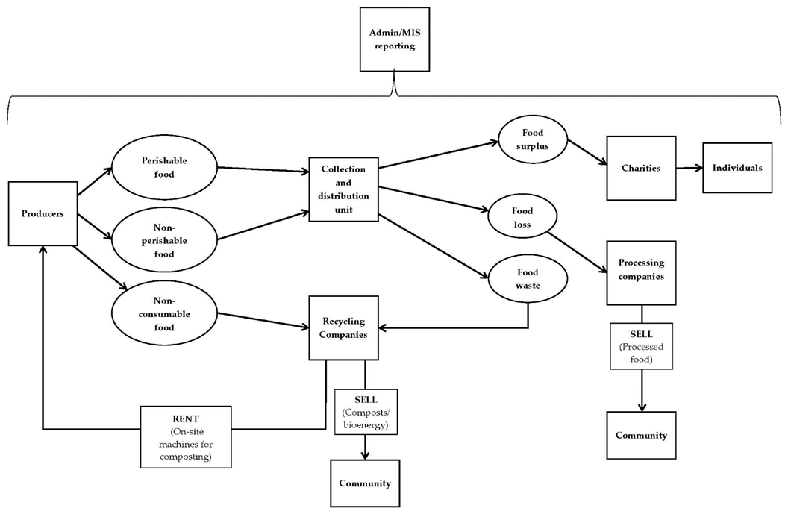
SYSTEM ARCHITECTURE

Slide 7
LIST OF MODULES
User Module
Admin Module
Delivery Module

Slide 8
USER MODULE
1. User Module
Purpose:
The User module is for individuals, restaurants, marriage halls, and other entities with surplus food they wish to donate.
Key Features:
Registration and Login: Users can create accounts and log in to the platform.
Food Donation: Users can input details about the type and quantity of food they wish to donate. The system will then match
their donation with the nearest needy people or organizations.
Donation Tracking: Users can view the status and history of their donations.
Notifications: Users receive updates about their donations, including when and where the food has been picked up and
delivered.
Workflow:
User Registration: Users sign up and create a profile.
Login: Users log in to access the donation features.
Donation Entry: Users specify the type and quantity of food available for donation.
Matching: The system matches the donation with a nearby NGO or charity.
Status Updates: Users are notified about the status of their donation until it is successfully delivered.

Slide 9
ADMINISTRATOR MODULE
2. Administrator Module
Purpose:
The Admin module is for system administrators and registered organizations like trusts, NGOs, and charities that manage the food distribution process.
Key Features:
Donation Management: Admins receive and list donations from the User module for NGOs and charities to choose from.
Request Handling: NGOs and charities can select and request specific food donations.
Tracking and Reporting: Admins can track the status of each donation, from request to pickup and delivery.
User and Organization Management: Admins manage user accounts and the registration of new NGOs and charities.
Workflow:
Donation Reception: Admins receive donation information from users.
Listing Donations: Donations are listed and made available for NGOs and charities to view and select.
Request Processing: NGOs and charities request donations they need.
Monitoring: Admins monitor the entire process, ensuring efficient handling and distribution.
Reporting: Admins generate reports on donation activities, including food types, quantities, and recipient organizations.

Slide 10
DELIVERY PERSON MODULE
3. Delivery Person Module
Purpose:
The Delivery Person module is for individuals who provide transportation services to pick up and deliver food donations.
Key Features:
Registration: Delivery personnel can sign up and create a profile on the platform.
Pickup and Drop-off Management: Delivery personnel receive details about pickup and drop-off locations for food donations.
Route Optimization: The system suggests optimal routes for efficient delivery.
Status Updates: Delivery personnel update the system on the status of pickups and deliveries, providing real-time tracking.
Workflow:
Registration: Delivery personnel register and create a profile.
Assignment: They receive assignments for pickups and drop-offs from the Admin module.
Pickup and Delivery: Delivery personnel collect the food from donors and deliver it to the specified NGOs or charities.
Confirmation: They update the system once the delivery is completed, which notifies both the donor and the recipient.

Slide 11
OVERALL WORKFLOW
Food Donation: Users register, log in, and donate food through the User module.
Donation Listing: Admins receive and list these donations for NGOs and charities in the Admin module.
Request and Pickup: NGOs and charities request specific donations. The Delivery Person module manages the logistics of picking up and delivering these donations.
Distribution: Delivery personnel transport the food from donors to recipients.
Tracking and Reporting: Throughout the process, all modules provide updates and reports to ensure transparency and efficiency.
This system effectively reduces food waste by ensuring that excess food reaches those in need, benefiting the community and promoting sustainable practices.

Slide 12
SECURE LOGIN
A hashing algorithm is a mathematical function that converts an input (or "message") into a fixed-size string of bytes. The output, typically a hash code, digest, or simply a hash, is unique to each unique input, meaning that even slight changes to the input produce significantly different outputs. Hashing algorithms are widely used in computer science for tasks such as data retrieval, digital signatures, and data integrity verification. They are designed to be fast and efficient, with good hashing algorithms distributing inputs uniformly across the possible output values to minimize the chance of collisions (different inputs producing the same output). Examples include MD5, SHA-1, and SHA-256.

Slide 13
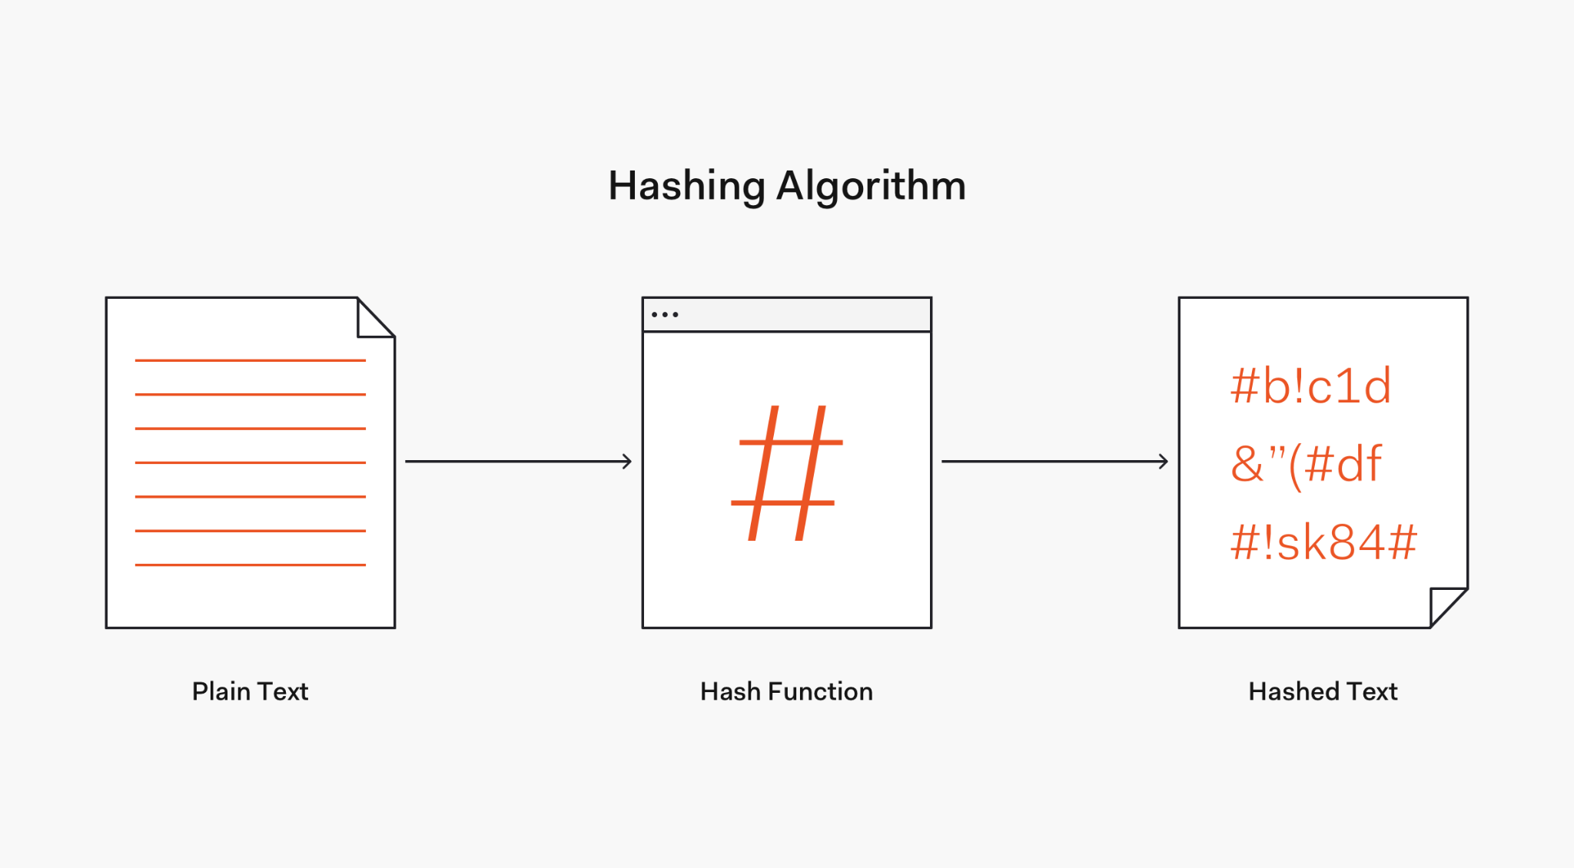
SECURE LOGIN

Slide 14

HOME PAGE

Slide 15
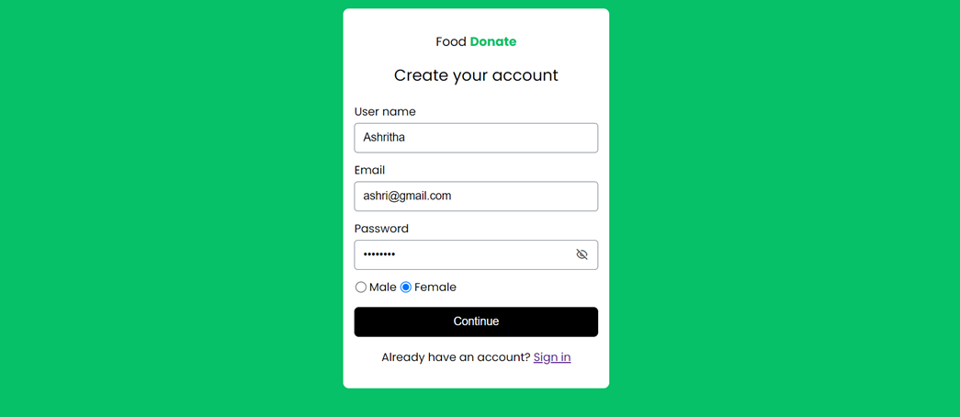
REGISTER PAGE

Slide 16
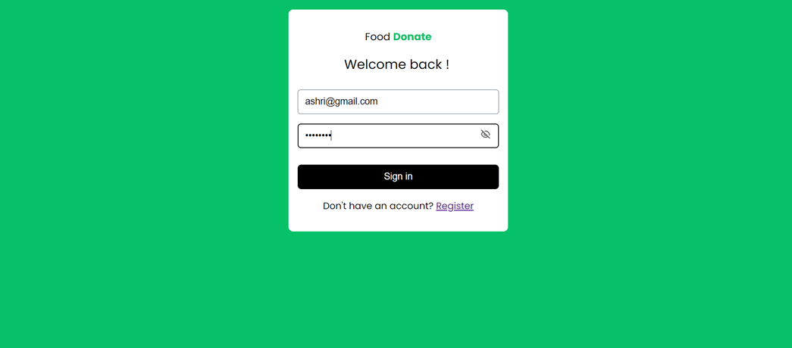
LOGIN PAGE

Slide 17
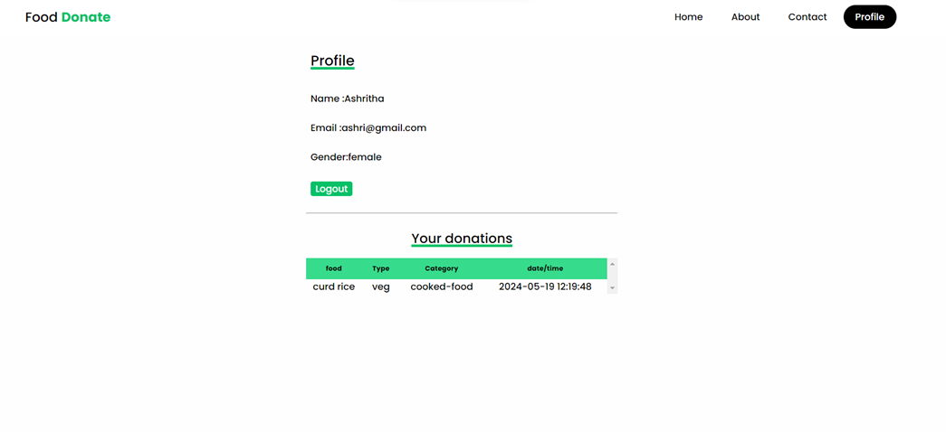
PROFILE PAGE

Slide 18
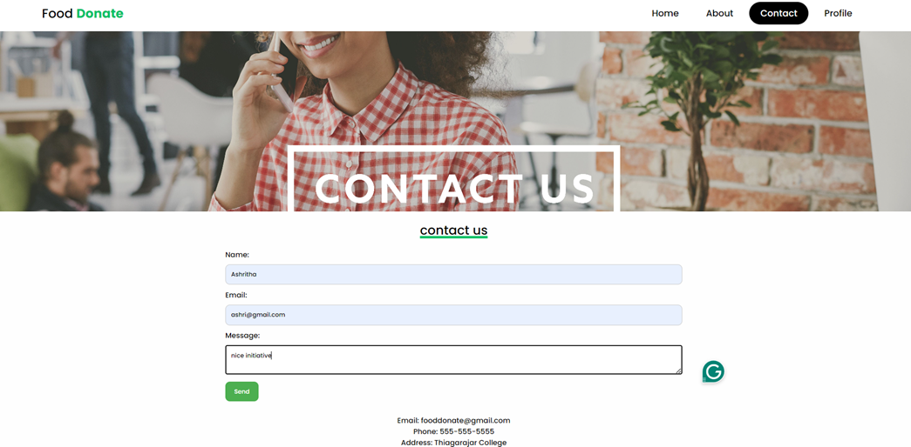
CONTACT PAGE

Slide 19
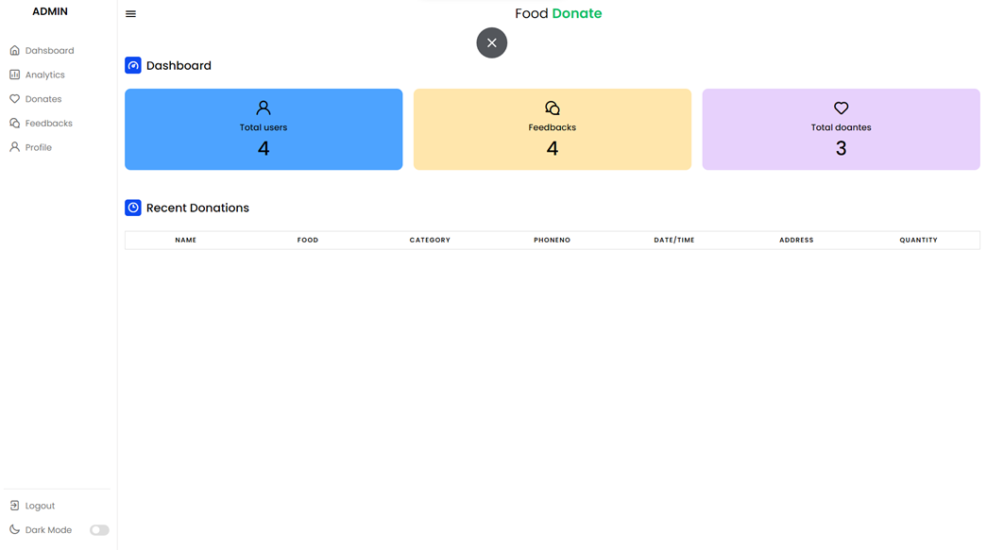
ADMIN DASHBOARD

Slide 20
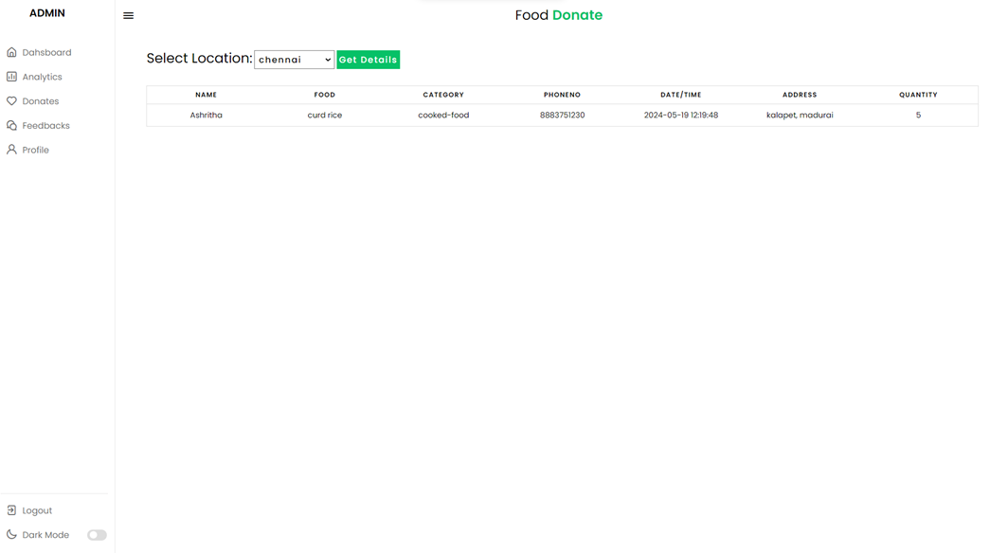
DONATION DETAILS

Slide 21
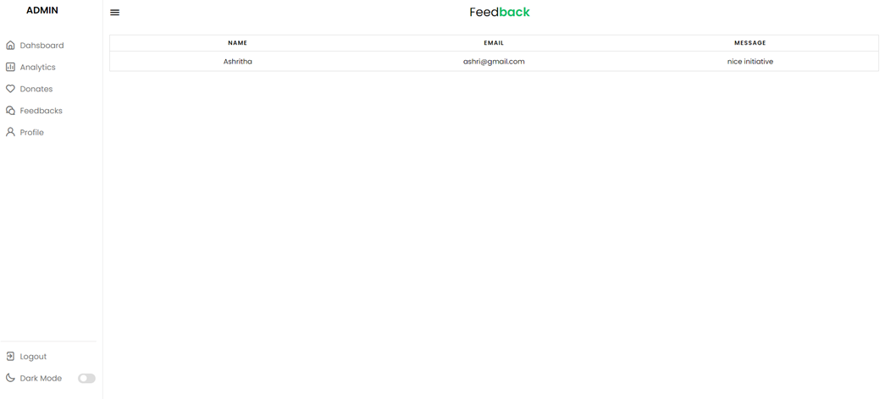
FEEDBACK

Slide 22
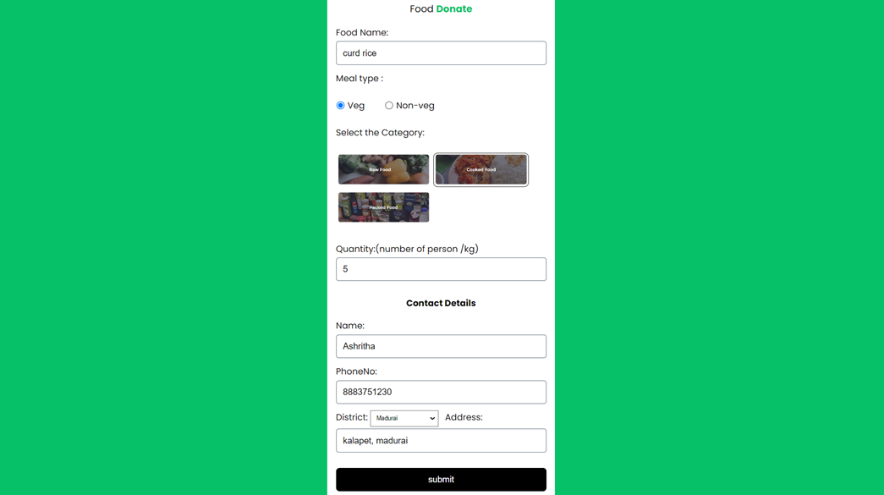
DONATE PAGE

Slide 23
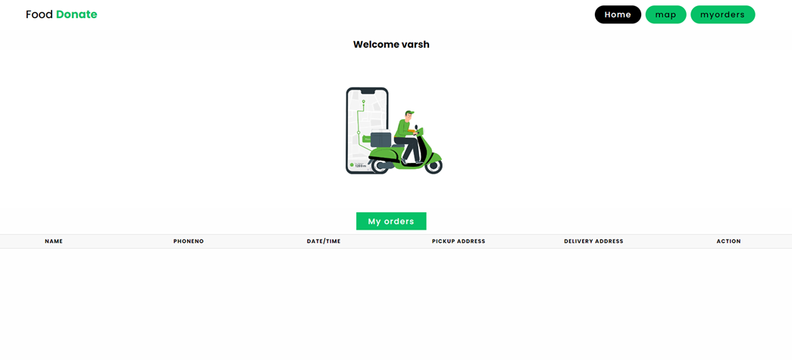
DELIVERY

Slide 24
CONCLUSION
In conclusion, the Food Surplus Management System project addresses a critical need in contemporary society by providing an efficient and effective solution for managing food surpluses. By leveraging technology to facilitate the redistribution of excess food, this system not only helps in mitigating food waste but also plays a pivotal role in combating food insecurity.
Through our comprehensive approach, incorporating data collection, real-time tracking, and user-friendly interfaces, the system ensures that surplus food is quickly and safely redirected from donors to those in need. The successful implementation of this system has demonstrated the potential for significant positive impact, including environmental benefits through waste reduction, economic advantages by optimizing food resource utilization, and social benefits by supporting communities and individuals facing food scarcity.
Moreover, the collaborative framework of the Food Surplus Management System, engaging stakeholders from various sectors such as non-profits, businesses, and government agencies, underscores the importance of a united effort in addressing food waste. The project highlights the importance of sustainable practices and the need for continued innovation in the field of food management.
Looking forward, the scalability of this system offers promising opportunities for wider application across different regions and contexts. Future developments could focus on enhancing predictive analytics, expanding the network of participants, and integrating more advanced technologies to further streamline operations.
Overall, the Food Surplus Management System stands as a testament to how strategic planning and technological innovation can come together to solve real-world problems, fostering a more sustainable and equitable food distribution network.

Slide 25
REFERENCES
1. Geissdoerfer, M.; Savaget, P.; Bocken, N.M.P.; Hultink, E.J. The Circular Economy—A New Sustainability Paradigm? J. Clean. Prod. 2017, 143, 757–768.
2. Voulvoulis, N. Transitioning to a Sustainable Circular Economy: The Transformation Required to Decouple Growth from Environmental Degradation. Front. Sustain. 2022, 3, 859896.
3. Liu, Y.; Wood, L.C.; Venkatesh, V.G.; Zhang, A.; Farooque, M. Barriers to Sustainable Food Consumption and Production in China: A Fuzzy DEMATEL Analysis from a Circular Economy Perspective. Sustain. Prod. Consum. 2021, 28, 1114–1129.
4. El Bilali, H.; Ben Hassen, T. Food Waste in the Countries of the Gulf Cooperation Council: A Systematic Review. Foods 2020, 9, 463.
Zafar, S. Waste Management Outlook for the Middle East. In The Palgrave Handbook of Sustainability: Case Studies and Practical Solutions; Palgrave Macmillan: London, UK, 2018; pp. 159–181.

Slide 26
THANK YOU

